Slide 1
Starting your Own AT Business:
Ideas for new market areas
Jeff Symons. MSE, ATP
Rehabilitation Engineer/Enginerd
www.jeffsymonsconsulting.com

Slide 2
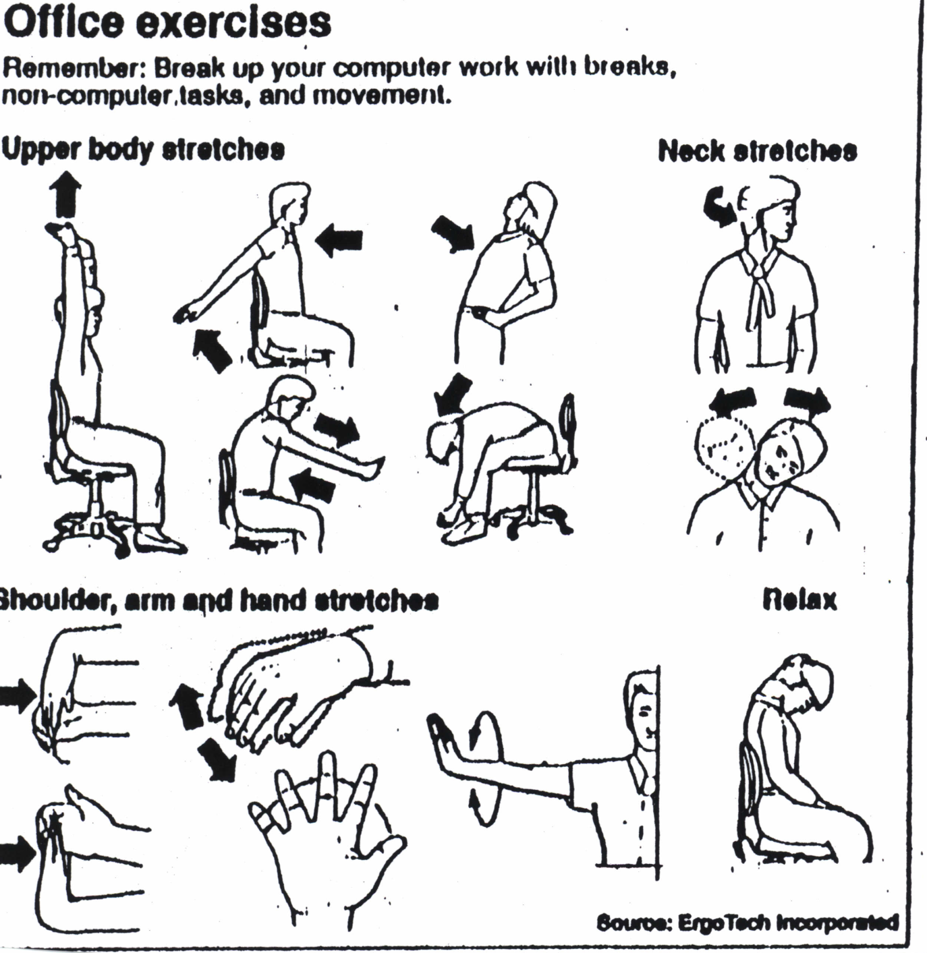

Slide 3
My Background:
Worked in AT for 25 years with RERC, California Dept. of Rehab. and Private Company
Started my own business in 2009 (why company went out of business)

Slide 4
What is your background and interest?
How many Engineers/Enginerds
Speech Paths
OT’s
PT’s
Others
SOB’s
What area do you work in, seating, aac, work site etc?
Any have the own business?

Slide 5
10 Steps to Starting a Business
Starting a business involves planning, making key financial decisions and completing a series of legal activities. These 10 easy steps can help you plan, prepare and manage your business. Click on the links to learn more.
Step 1: Write a Business Plan
Use these tools and resources to create a business plan. This written guide will help you map out how you will start and run your business successfully.
Step 2: Get Business Assistance and Training
Take advantage of free training and counseling services, from preparing a business plan and securing financing, to expanding or relocating a business.
Step 3: Choose a Business Location
Get advice on how to select a customer-friendly location and comply with zoning laws.
Step 4: Finance Your Business
Find government backed loans, venture capital and research grants to help you get started.
Step 5: Determine the Legal Structure of Your Business
Decide which form of ownership is best for you: sole proprietorship, partnership, Limited Liability Company (LLC), corporation, S corporation, nonprofit or cooperative.
Step 6: Register a Business Name ("Doing Business As")
Register your business name with your state government.
Step 7: Get a Tax Identification Number
Learn which tax identification number you'll need to obtain from the IRS and your state revenue agency.
Step 8: Register for State and Local Taxes
Register with your state to obtain a tax identification number, workers' compensation, unemployment and disability insurance.
Step 9: Obtain Business Licenses and Permits
Get a list of federal, state and local licenses and permits required for your business.
Step 10: Understand Employer Responsibilities
Learn the legal steps you need to take to hire employees.

Slide 6
Business Plan
A business plan is an essential roadmap for business success. This living document generally projects 3-5 years ahead and outlines the route a company intends to take to grow revenues.BusinessB
_{article}
_{Executive Summary}
Your executive summary is a snapshot of your business plan as a whole and touches on your company profile and goals. Read these tips about what to include.
_{article}
_{Company Description}
Your company description provides information on what you do, what differentiates your business from others, and the markets your business serves.
_{article}
_{Market Analysis}
Before launching your business, it is essential for you to research your business industry, market and competitors.
_{article}
_{Organization & Management}
Every business is structured differently. Find out the best organization and management structure for your business.
_{article}
_{Service or Product Line}
What do you sell? How does it benefit your customers? What is the product lifecycle? Get tips on how to tell the story about your product or service.
_{article}
_{Marketing & Sales}
How do you plan to market your business? What is your sales strategy? Read more about how to include this information in your plan.
_{article}
_{Funding Request}
If you are seeking funding for your business, find out about the necessary information you should include in your plan.
_{article}
_{Financial Projections}
If you need funding, providing financial projections to back up your request is critical. Find out what information you need to include in your financial projections for your small business.
_{article}
_{Appendix}
An appendix is optional, but a useful place to include information such as resumes, permits and leases. Find additional information you should include in your appendix.
_{article}
How to Make Your Business Plan Stand Out
What makes your business unique? Determining this could help you stand out from the crowd and give you advantages over your competitors.

Slide 7
How do i become a self-employed assistive technology practitioner?
Like
Report
Share: Facebook Twitter Other
Sort answers by: Answers. 1 helpful answer below.
by John Heller on May 9th, 2010

Slide 8
Great Answer
Professionally Researched. (What's this?)
An assistive technology practitioner organizes and sets up technology in offices, schools and homes for people who are disabled and need special equipment to perform everyday tasks. Although some businesses and schools employ pertinent people to set up and teach workers how to use this technology, many more workers in this field freelance for themselves.Self Employment in Assistive Technology
A person should be familiar with assistive technology and how it benefits the disabled and be able to use any of the equipment they are setting up, such as braille readers and magnifying technology. Once familiar with the technology, there are a few ways to start freelancing as a self employed assistive technology practitioner. First contact businesses in your area and tell them about the services you offer. Its best to have a strong resume of experience and references or testimonials to show potential employers that you are the right person for the job.
If you feel the experience on your resume is not robust enough to get jobs as a freelancer another great way to enter the field is to volunteer at disability centers. Because the disability community is fairly small, a lot of freelancers find familiarizing themselves with the community both gives experience for resume's as well as provides referrals to businesses or people that need the help. Many freelancers in the field get work from referrals within the disabled community.
Contacting human resources departments of businesses and staffing agencies is a great way to grow your freelance business because they see a lot of people and are tasked to make sure they can find positions for all employees. Many company's want to hire disabled people but do not know about the technology that can give a good employee everything they need to succeed. Finally, many large businesses and corporations use companies like Kurzweil Educational Systems or Freedom Scientific to help them with their assistive technology needs. These company's hire online and specialize in employing outside contractors to work with businesses in many areas of assistive technology.
Source:
4dewitt.com: Training in Assistive Technology
Read more: How do i become a self-employed assistive technology practitioner? | Answerbag http://www.answerbag.com/q_view/2058844#ixzz2Wm6UYXp0

Slide 9
Things to think about before you Start
What types of service can I provide?
  You may have to expand
What types of services are needed?
  How do I determine this (TALK TO FUNDING SOURCES)
  Who are the funding sources and what do they need?
What are my goals financially and personally?

Slide 10
What types of services can I provide?
Look for markets etc. that apply to larger number of people. i.e. Ergonomics
Where are new opportunities/markets?
Selling vs. not selling (resellers license), funding sources, repairs etc.
Diversity helps

Slide 11
My Financial goal:
How much do I need to make and how much do I want to make?
I am the worst case. Wife works but does not get health insurance. 2 kids in college.
Figure about 1/3 of salary for health care retirement etc.

Slide 12
What can I charge?
Survey other professional who do similar work in the area.
I spoke to other ATP’s and ergonomist
They charge from 100-150/hr.

Slide 13
My Goal:
100,000 per year (minus 30% for health care, retirement)
If I charge 100.00/hr.
1000 hours for the year/50 weeks
Need to bill 20 hours per week at 100.00/hr to reach goal
This will be easy, I can work ½ time and meet my goal. My golf game will get much better.

Slide 14
Reality
Started out small and have other consulting business
1st 2 years worked mostly with Dept of Rehab. and had about 40-50K
Realized I had to find other funding sources to make this work
Last 2 years with more funding sources business is growing still not at goal 60-80K
My golf game is not very good

Slide 15
Start out small
Start out in areas you know and then branch out. Can get additional training/certification
Have a goal in mind so you can see how you are doing.

Slide 16
Insurance
OT’s, PT’s, Speech Path can get insurance from a number of sources
Engineers much harder for this area
ATP I found 1 place to for insurance HPSO

Slide 17
Expenses
Equipment
Gas
Printing
Insurance
Web Site
Others??? Rent etc.

Slide 18
Naming your business
Not as easy as it sounds
Here are seven things I consider when determining a business-related name:
1. The name needs to sound good when it's said aloud
2. Use a name that has meaning to it and conveys a benefit.
3. Avoid Web 2.0-ish syndrome.
4. Beware initials. URL Listing
5. Use specifics.
6. Make sure you can trademark the name.
7. Test it out on Google AdWords.

Slide 19
I do not like the name of my company:
Jeff Symons Consulting
When I started I did not think it would be my main job. I spoke with some business types and if people know your name and you think you have a good reputation and one they will recognize than maybe it is OK.
Hard to change once on State lists etc.

Slide 20
Name I would like:
Mobile
Rehabilitation
Engineer

Slide 21
What not to name your company
Consider URL, initials etc.
Sensory Aids/Sensory Access
Department of Corporations/Department of Business oversight
My apologies
Google top 10 worst names

Slide 22
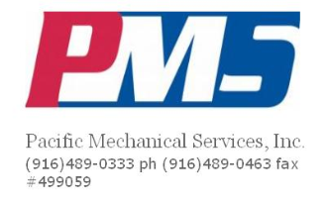

Slide 23
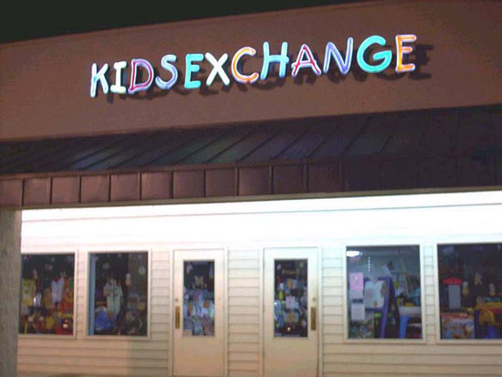

Slide 24
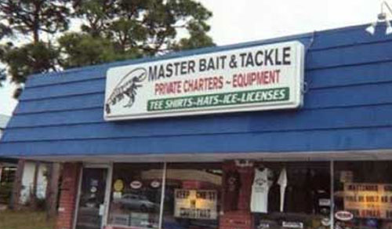

Slide 25
BAD URL NAMES
1. A site called ‘Who Represents‘ where you can find the name of the agent that represents a celebrity. Their domain name… wait for it… is
www.whorepresents.com
2. Experts Exchange, a knowledge base where programmers can exchange advice and views at
www.expertsexchange.com
4. Need a therapist? Try Therapist Finder at
www.therapistfinder.com
9. Then, of course, there’s these brainless art designers, and their whacky website:
www.speedofart.com
10. Want to holiday in Lake Tahoe? Try their brochure website at
www.gotahoe.com

Slide 26
Once you find a name
Open a business checking account
Dedicate one of your credit cards for business expenses only
Talk to an accountant, preferably someone with small businesses experience - An accountant can help you understand things like how to pay quarterly taxes, how to structure your business (e.g., sole proprietorship, LLC, S Corporation), and what business expenses are deductible.

Slide 27
Talk to an insurance agent or broker – There are several types of insurance you will want to have for yourself: health insurance, disability insurance, and general liability insurance are among the most common. Not easy to do if not and OT, PT Speech. HPSO for ATP
Print business cards
Set up a “safe” mailing address PO Box
Set up a business phone line –
Set up a dedicated office space

Slide 28
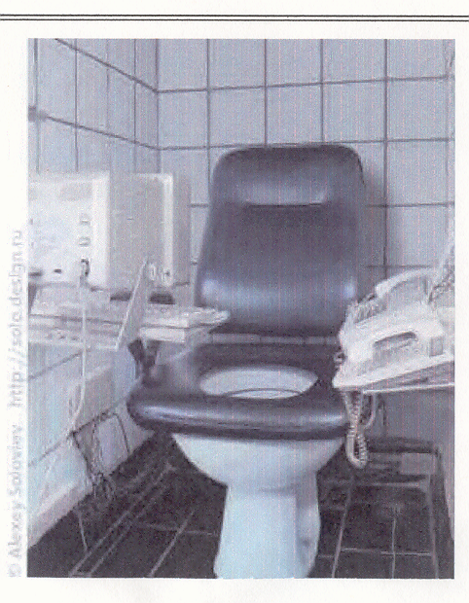
My Office
        My Office

Slide 29
Find an anchor client – Easier said than done, it is tremendously helpful to find an “anchor” client. An anchor client provides you with about 25% of your business revenue for several years, so that you are at least guaranteed you can pay your rent or mortgage! Or a anchor business area.
Network, network, network

Slide 30
Type of Business
Sole proprietorships and limited liability companies (LLC) are similar in the fact that they are both examples of the many different types of businesses that an individual can create. However, a sole proprietorship is very different from an LLC and there are a number of advantages and disadvantages that the potential owner(s) of a sole proprietorship or an LLC should be aware of before choosing to form a company.
Size
  A sole proprietorship must have a single owner. An LLC, on the other hand, may have any number of owners as long as it has at least one owner (in most states.)
Liability
  A sole proprietor may be held personally liable for all of his company's debts while the owners of an LLC are only responsible for debts up to the amount that they invested (in most cases.)
Property
  The owner of a sole proprietorship owns all of the company's assets . However, the assets of an LLC are the property of the company itself and not the property of the LLC's owners.
Formation
  An individual can form a sole proprietorship simply by acquiring the permits that she needs to start the business (if any are required) while an LLC must file with the state.
Taxes
  A sole proprietorship must report its income on its owner's personal tax return while an LLC may choose to file taxes as a sole proprietorship (if it has a single owner), a partnership, or a corporation.

Slide 31
Risks of Personal Liability. Under the sole proprietorship, you and your business are viewed as one in the same. Therefore, you have unlimited personal liability for all of the debts and legal liabilities of your sole proprietorship. Your personal assets, such as your home or personal bank account, could be at risk to satisfy unpaid debts, legal judgments, and other legal obligations of your start-up. On the other hand, an LLC is a separate legal entity and an LLC member is normally not personally liable for the LLC’s debts or legal liabilities. As an LLC owner, you are mainly putting your financial contribution to your LLC, not your other personal assets, on the line. However, as an LLC owner, you may still be personally liable for your own conduct or LLC loans in some cases. For example, you may still be responsible if you personally guaranteed repayment of an LLC loan or if your own acts cause harm to a third party or to your LLC. Like any business person, it is important to consider appropriate liability and other forms of insurance to help protect your personal assets and your business. Overall, the sole proprietorship tends to expose a business owner to greater risks of personal liability. Assessing your comfort level with personal liability risks should be an important aspect of your decision-making process.

Slide 32
Reasons for Insurance
Client help with equipment
Trips and falls
Monitor arm on desk
What we cannot think of

Slide 33
Certification
Can add credibility
ATP /RET/SMS
Ergonomics Certification http://www.bcpe.org/ http://thebackschool.net/coursesdetail.cfm?ItemId=45

Slide 34
Certification
Certified Aging in Place Specialist http://www.nahb.org/category.aspx?sectionID=686
Accessibility
CAPS http://www.nahb.org/category.aspx?sectionID=686
http://www.accesshomeamerica.com/ceac.asp

Slide 35
Create a Web site
Software
Template services Ipage.com

Slide 37
Getting Started
Advertizing
Gathering equipment
Getting new clients
Assessments
Problem Solving

Slide 38
Advertizing
In –services most effective way I have found to get clients Funding Sources Dept. of Rehab.
Retail Location, location, location
Consulting Reputation, Reputation, Reputation
Keep name in front of them- Newletter
Facebook/Twitter social media
Follow up

Slide 39
Marketing Equipment/

Slide 40
Marketing Equipment/Device
Patent/non disclosure form
Market to end user?
Market to reseller
Widget ex.

Slide 41
In-Services
Most places have trainings for small groups.
Usually ½ hour -1 hour
Tailor talk to their needs
Get there contact info
Effective way to advertize

Slide 42
Shows
MAKE SURE YOU GET THEIR CONTACT INFO OR CARD. SEND THEM INFO.
Bring devices they can try
Bring a cute puppy
Have a raffle – free assessment
$59.00 air conditioning tune up

Slide 43
Dealing with companies /clients
1st question How much will it cost?
Answer $500-1000.00 but let me tell you how much money I can save you
You can look at by something from a catalog and it may or may not work. Can you return it?

Slide 44
I can have you try things to make sure they work and you do not waste your time and money
  Ex. Ergonomic chairs

Slide 45
Vendors
Great source for referrals and equipment
I work with a variety of different vendors and they will loan me any piece of equipment I need
Company reps- another good source for equipment and referrals
Examples- Office Relief, General Technologies, speech amplification systems
Can buy and return equipment - Infogrip
Loan Programs

Slide 46
Equipment
What do I need and where can I get it
Vendors
ALS Society
Thrift Stores

Slide 47
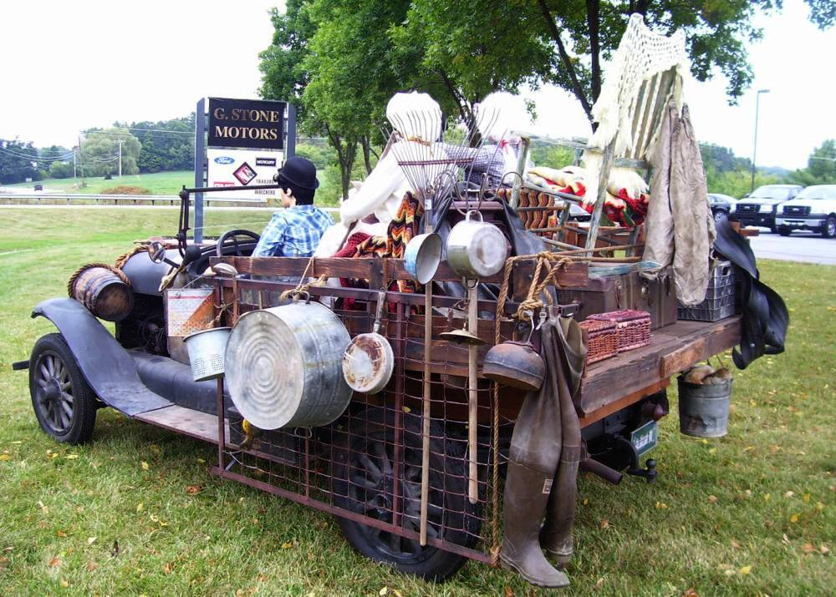
My Car

Slide 48
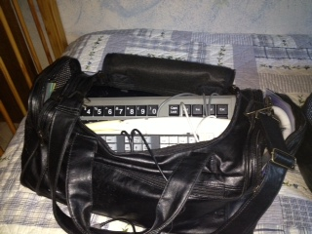
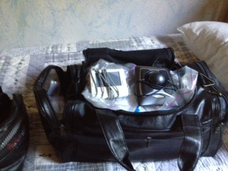
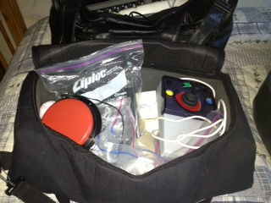

Slide 49
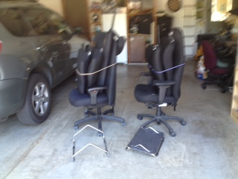
Chairs and footrest

Slide 50
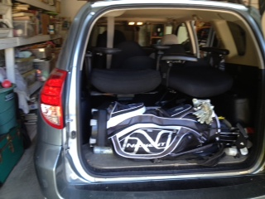
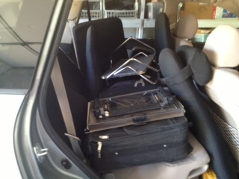
Golf Clubs hold chairs in
Note Golf clubs hold in equipment

Slide 51
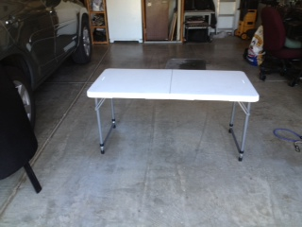
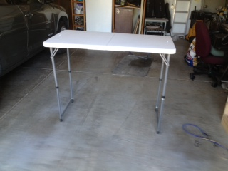
Lifeline folding adjustable table 22-38”

Slide 52
Assessments
Do you have to solve the problem during the assessment.
What to bring- Everything
Who attends the assessment- Have the DOR counselor attend if you have not worked with them. Funding or referral source.
Advantages and Disadvantages of devices

Slide 53
Problems Solving
Defining the problem – specific or general?
Examples:
  Visually Impaired Cashier
  Taking books to class Arthrogyposis

Slide 54
Adopt the beginner's mind. As the old saying goes, in the expert's mind there are few possibilities, but for one with the beginner's mind, the world is wide open. Designers understand the need to take risks, especially during early explorations of the problem. They are not afraid to break with convention. Good designers are open minded and comfortable with ambiguity early on in the process, this is how discoveries are made.

Slide 55
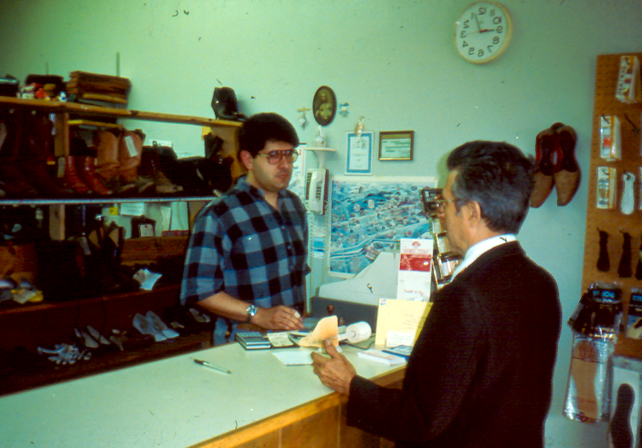

Slide 56


Slide 57


Slide 58


Slide 59


Slide 60
Home Assessments
  Home Assessment Survey
  http://www.ca.uky.edu/hes/fcs/FACTSHTS/HF-LRA.018.PDF

Slide 61
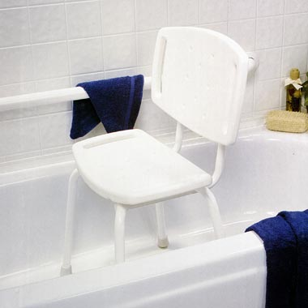

Slide 62
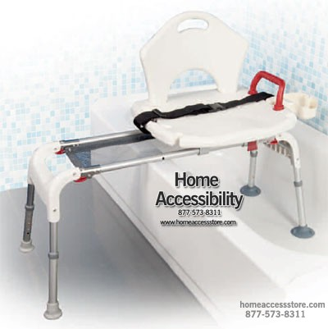

Slide 63
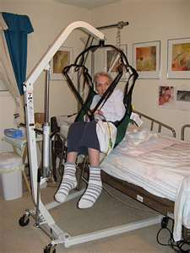
Hoyer type lift
Can be hard to roll
on carpet
Can be hard to get
through doors

Slide 64
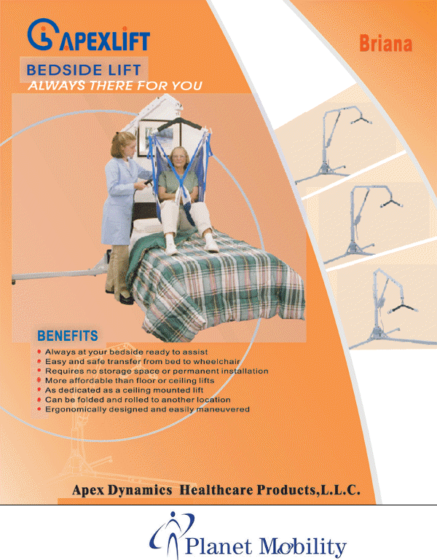
New Stuff all the time

Slide 65
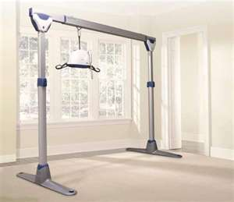

Slide 66
Elderly Clients
Include family members or others if possible
Issues
Vision - CCTV, Hand held magnifier
Hearing- Assistive Listening devices
Mobility- BATHROOM, TRANSFERS
Memory- MEDICATION
Technology- GPS

Slide 67
What to do with difficult clients?
I say I will document your concern. That does not mean I am going to recommend it.

Slide 68
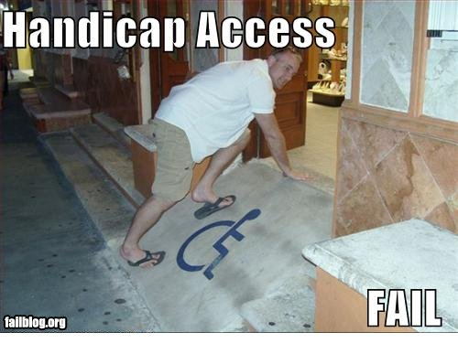
Accessibility Surveys

Slide 69
There are a number of online accessibility surveys for home and business. Find one that works for you.
Business- some for certain business such as hotels etc.
http://www.lawv.net/system/files/ADA%20Hotel%20Checklist.pdf
Ritz Carleton example

Slide 70
Accessibility Surveys
How do I learn how to do them. Before doing your first one practice. Try it at your home and try it at a business.

Slide 71
Training
How to use device
Voice recognition training
Speech training – not a speech therapist

Slide 72
Markets Areas
Assisted Living
Retirement Communities
Schools
Disability Societies
Work Areas
Vendors –Brochures, cards

Slide 73
Assisted Living
Inservices
Talk to family members

Slide 74
Look for Opportunities
AAA example

